Slide 1
Internet of Things
Module 6, Lesson 2:
IoT in Azure

Slide 2
Topics
Key Components of IoT
IoT Application
IoT in Azure

Slide 3
Objectives
By the end of this lesson you should be able to:
Understand key components of IoT
Understand IoT Application
Understand IoT Azure solution

Slide 4
Context-Aware Sensors
Sensors are used to acquire context information
Sensors can be made to be aware of their own context
Aware
Context
Information
Sensor
Acquire

Slide 5
Context-Aware Sensor frameworks
Frameworks
Sensors are used to acquire context information
Sensors can be made t be aware of their own context
Analyzing sensor data streams for contextual information
Mapping the discovered context into respective triggers
Using the triggers to execute power management functions
Notes:
Notes:
Context-aware sensor framework:
Establishing patterns for controlling sensor activity, either programmed by developers or acquired by learning from sensor data
Framework – consist of 3 items:
Sensors group components
Support services component : provides communication between sensors and system. context locator service, context mining service,
Context trigger engine component : Core functions for context discovery and use.

Slide 6
WSN : Wireless Sensor Network
WSN : Wireless Sensor Network
Consisting of sensing, processing, and communicating components, networked through wireless links between nodes
Large number of sensor nodes are deployed over an area
Mesh network: relay sensed information to base station
Notes:
Notes:
WSN: a combination of low cost, low-power, multifunctional miniature sensor devices consisting of sensing, data processing, and communicating components, networked through wireless links between neighboring nodes.

Slide 7
Key Component of Frameworks
Sensor groups
Communication server
Context locator service
Notes:
Notes:
Sensor group
Send sensor readings to communication server
Receive sensor control commands from “Context Trigger Engine” via communication server.
Communication server
Acts as a mediator between the base station and the sensors
Context locator service
Interpret the current context from the raw sensor readings

Slide 8
Key Component of Frameworks (Cont.)
Context mining service
Context trigger engine
Context action data store
Notes:
Notes:
Context mining service
Context discovered autonomously in the system
Context trigger engine
Determines the sensor operations triggered using a combination of given context and sensor profiles
Context action data store
Relationship between context and its respective actions.

Slide 9
Key Component of Frameworks (Cont.)
Context
Sensor group
Context
Actions
Data store
Request
Context scheduler
Action macro
Time to trigger
Macro Decoder
Action
Operation
DB
Sensor
profile
operations
Action Interpreter
Sensor ID
Sensor control
Message Sensor command
Notes:
Notes:
Action macros – a command or a combination of a actual commands sent to sensors

Slide 10
Security
Traditional Security models
Confidentiality
Integrity
Availability
Notes:
Notes:
Confidentiality
Authentication process of ensuring that the identity declared
Enabling access to the right parties
Integrity
The information can be trusted and has not been tampered
Availability
Handling the information being accessible by authorized parties in the required circumstances

Slide 11
Security Policy
Traditional Security is based on the concept of roles and tasks affected to these roles
Specifies security responsibilities
Assets or protects – Hardware, Software, Data, Networks
Mechanisms – Cryptography, Access control, Authentication & identification, Trust management
Notes:
References:
http://www.acsac.org

Slide 12
Context-Aware Security
Context based security supports the reconfiguration of the security infrastructure according to the situation of use.
Finer-grained security
Adaptable security levels
Increased traceability

Slide 13
Influences on Security models
Finer-grained security
Grouped context for the purpose of security decisions
Context can be used to enhance existing security measures
Adaptable security levels
Context Awareness : flexible security models can be achieved
Use of context : partial information access or full discourse based on situations

Slide 14
Influences on Security models (Cont.)
Increased Traceability
Without the full credentials, provide the permission, with the context of location, time and witness of the event record
Contexts improve traceability and enrich auditing, which can be traded for changes in required credentials or security levels

Slide 15
Context-Aware Security Policy
Formalisms for expressing context-aware security policies
Contextual graphs
Role-based XML languages
Notes:
Notes:
Context-aware Security Policy :
Contextual information of entities or situations within the rules of the policy
augmenting conditions for access to particular information
triggering change in the set of applicable security policies
Contextual graphs : a directed acyclic graph with a unique input, a unique output
Role-based XML : representing policies in XML format
Policy contains the followings Subject role, Object role, Action (on the object),
Environment role (the context of the action),
Permissions (whether the action is to be permitted or not)

Slide 16
Security Issues
Other related issues:
Privacy issue
use of context not so much for securing information as for securing context information
ex) protecting people’s location & tracking
Use of context in security infrastructures
False context can compromise security
Protecting the sensing and context gathering subsystems will be important → false information is not acquired
Security in Pervasive computing
Notes:
Notes:
Security in Pervasive computing :
vulnerabilities with wireless networking,
introduction of new unknown devices to an environment,
denial-of-service for openly available devices
integrity violations of critical wireless sensor data through intercepts

Slide 17
Applications of IoT
Applications of Networks and Sensors
Warehouse Inventory management
Smart Automotive
Smart Building control
Environmental monitoring
Military battlefield intelligence/security/Surveillance
Infrastructure protection
Notes:
Notes:
Warehouse Inventory management : RFID
Automotive Application Telematics, Traffic congestion warnings and route information,
Building monitoring and control : lighting, temperature conditions
Environmental monitoring : chemical hazard warning, tracking flood, extreme weather condition, earthquake detection with seismic sensor, wildlife habitat monitoring…
Military battlefield intelligence/security/Surveillance
Infrastructure protection : water distribution, power grids context-aware computing : intelligent homes, responsive environments

Slide 18
Requirements of IoT Application
Requirements | Health | Aviation | Home Automation | Smart Cars | Industrial Control
Latency | Long | Low | Long | Low | Low
Mobility | Pedestrian | High | No | High | Low
Security | High | High | High | High | High
Protocol message size | Short | Mix | Short | Mix | Mix
Frequency of interactions | Low | High | Low | High | High

Slide 19
What is IoT Suite?
Azure IoT Suite packages together multiple Azure services with custom extensions as preconfigured solutions.
Collect data from devices
Analyze data streams in-motion
Store and query large data sets
Visualize both real-time and historical data
Integrate with back-office systems

Slide 20
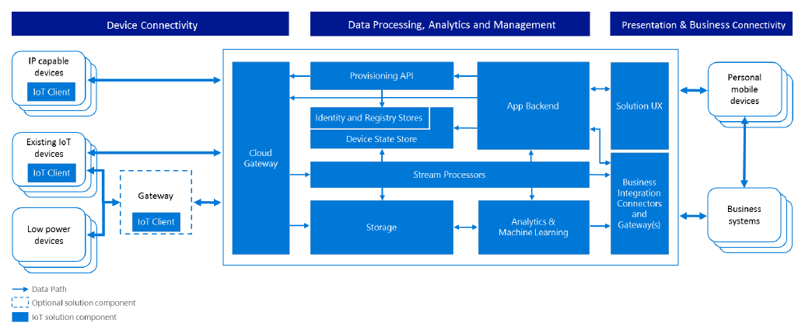
IoT Architecture in Azure
Notes:
Notes:
The architecture is composed of core platform services and application-level components to facilitate the processing needs across three major areas of a typical IoT solution:
Device connectivity
Data processing, analytics, and management
Presentation and business connectivity
References:
http://image.slidesharecdn.com/april141500microsoftthacker-160425201930/95/big-data-application-architectures-iot-13-638.jpg?cb=1461615600

Slide 21
IoT in Azure
Get started in minutes
Connect any device
Predict the future
Automate to transform
Cross platform
Azure has the widest range of compatibility
Device connectivity
Data processing and analytics
Order of Processing
Presentation

Slide 22
Summary
In this lesson, you have learned to:
Understand key components of IoT
Understand IoT Applications
Understand IoT Azure solutions

